Slide 1

AWS – S1
Hands-on Training
“deliver everything from A to Z with smiles to customers”
by
Audience:
AWS Operations- S1 AWS Development – S1 & AWS Solution Architect – S1

Slide 2

About V. Chinnajee Rao
IT Infrastructure trainer with 21 + years of experience
Core – AWS & DevOps with Linux
Certified – AWS Solution Architect - Associate at 2018
RHCE 4, Solaris 9 , AIX 6, VMware 3.5
Recertified - AWS Solution Architect – Associate at 13th Oct 2020
RHCSA – RedHat 8 – 10th March 2020

Slide 3
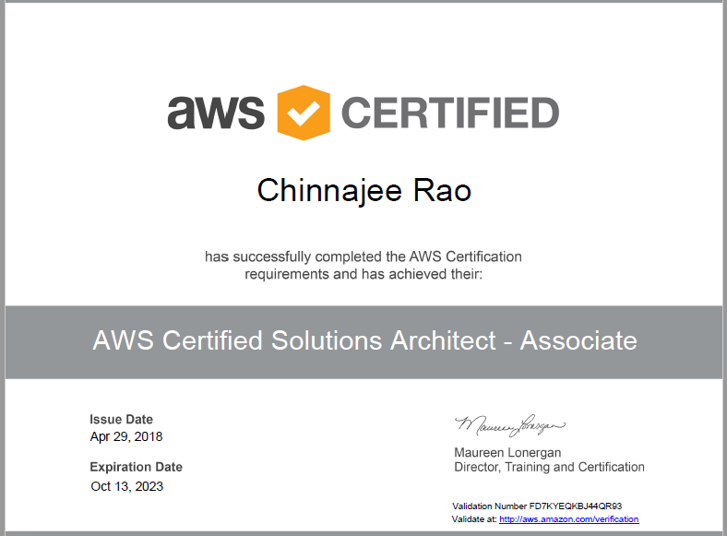

Slide 4
AWS Concepts
AWS and the Cloud
Introduction to Core AWS Services

Slide 5
Aws Concepts
AWS and The Cloud

Slide 6
TOC
What is virtualization
What is cloud computing
Vendors
AWS
Pricing
Job roles and certifications

Slide 7
In the computer-age…

Slide 8
A Lot of Servers/Machines...
Web server
Mail server
Database server
File server
Proxy server
Application server
…and many others

Slide 9
A Lot of Servers/Machines...
The data-centre is FULL
Full of under utilized servers
Complicate in management
Environmental problem
Green IT

Slide 10
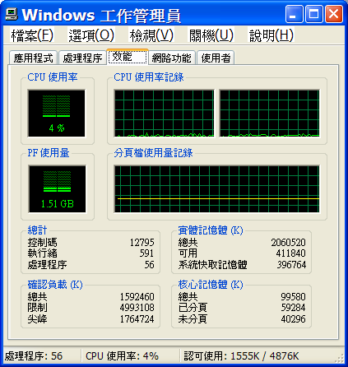
Capacity Utilization
Virtualized system (high)
High utilized*
Low utilized
Stand alone system (low)
* But not overloaded…

Slide 11
The first aid of this pain is ?
Virtualization

Slide 12
What is Virtualization?

Slide 13
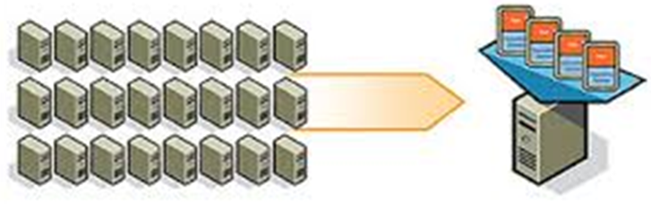
Virtualization
Virtualization -- the abstraction of computer resources.
Consolidating multiple servers into one physical server
Virtualization hides the physical characteristics of computing resources

Slide 14
Virtualization -- a Server for Multiple Applications/OS
Application
Application
Application
Applications
Application
Applications
Operating
System
Operating
System
Operating
System
Operating
System
Operating
System
Operating
System
Hardware
Hypervisor
Hardware
Hypervisor is a software program that manages multiple operating systems (or multiple instances of the same operating system) on a single computer system.
The hypervisor manages the system's processor, memory, and other resources to allocate what each operating system requires.
Hypervisors are designed for a particular processor architecture and may also be called virtualization managers.

Slide 15
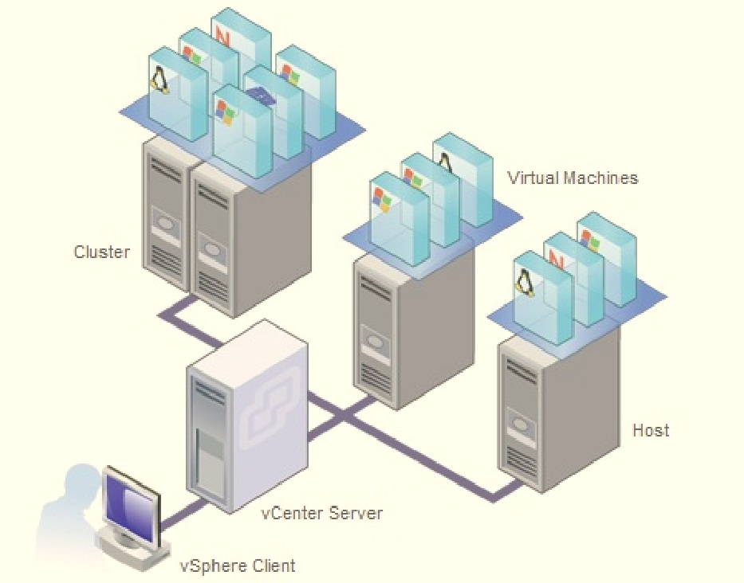

Slide 16

Software Defined Data Center

Slide 17
Capacity Utilization
Virtualized system (high)
High utilized*
Low utilized
Stand alone system (low)
* But not overloaded…

Slide 18
The first aid of this pain is ?
Cloud Computing

Slide 19
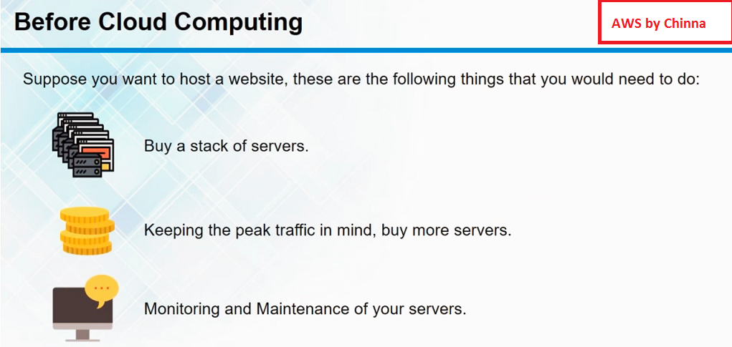

Slide 20
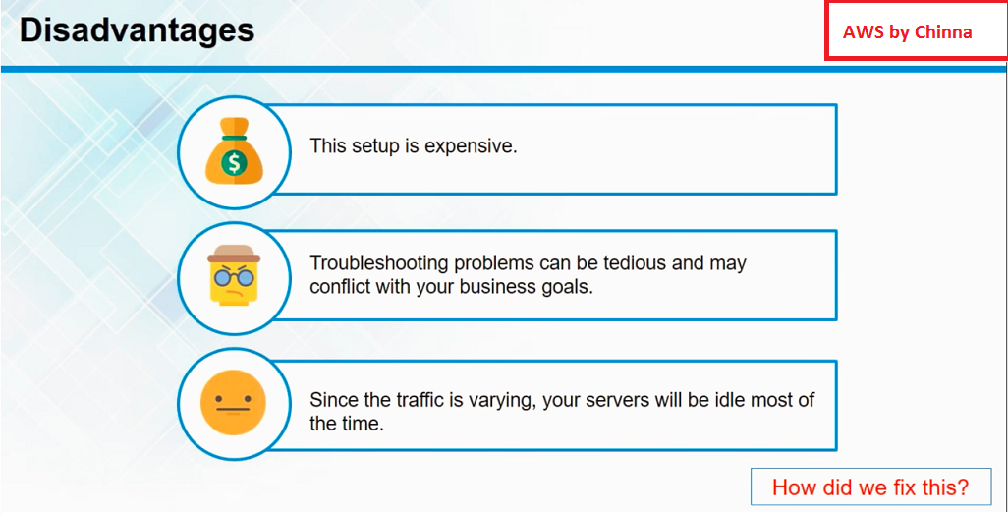

Slide 21
The first aid of this pain is ?
Cloud Computing

Slide 22

What is cloud computing?
Pay per use
As a service
Over web
Via internet
From any device – i.e PC, laptop, smart phone, tab

Slide 23
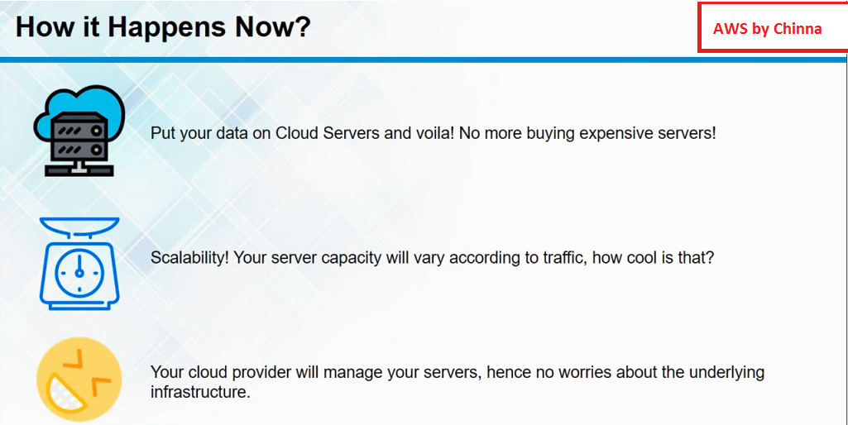

Slide 24
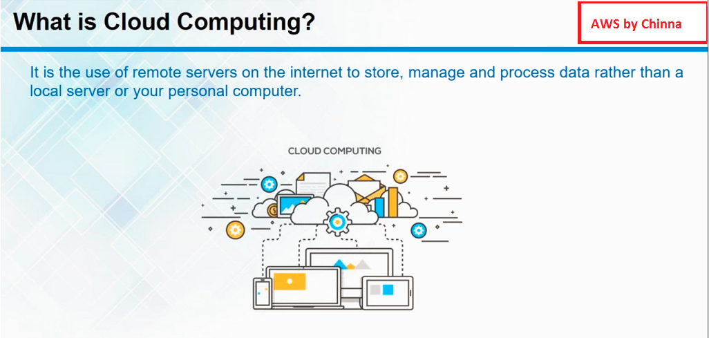

Slide 25
Why the Cloud?
On Premises
Infrastructure
(as a Service)
Platform
(as a Service)
Software
(as a Service)
Applications
Applications
You manage
Applications
Applications
You scale, make resilient and manage
You scale, make
resilient & manage
Data
Data
Data
Data
Runtime
Runtime
Runtime
Runtime
Scale, resilience and management by vendor
Middleware
Middleware
Middleware
Scale, resilience and management by vendor
Middleware
O/S
O/S
O/S
O/S
Virtualization
Virtualization
Managed by vendor
Virtualization
Virtualization
Servers
Servers
Servers
Servers
Storage
Storage
Storage
Storage
Networking
Networking
Networking
Networking

Slide 26
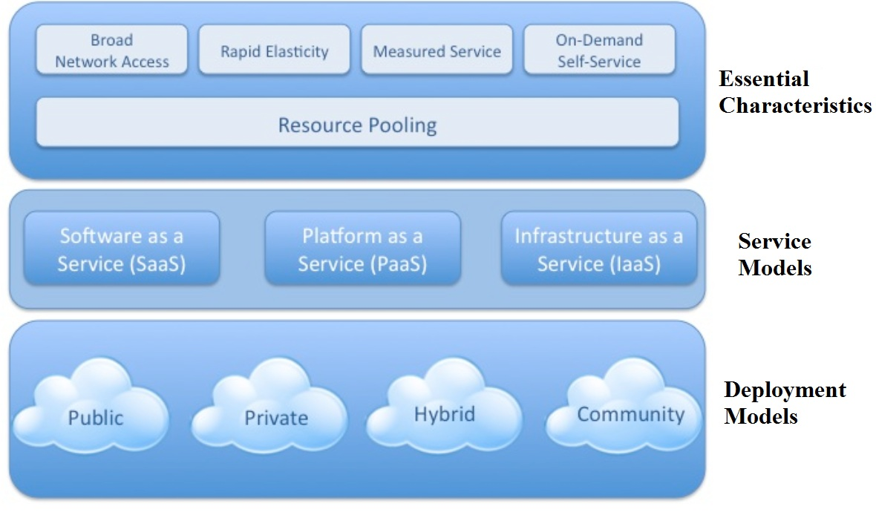
Architecture

Slide 27
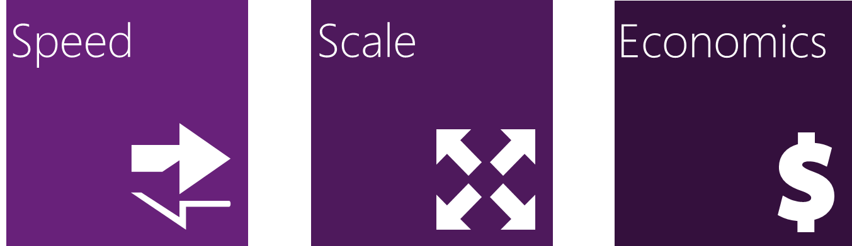
Why the Cloud?
Rapidly setup environments to drive business priorities
Scale to meet peak demands
Increase daily activities, efficiency and reduced cost.

Slide 28
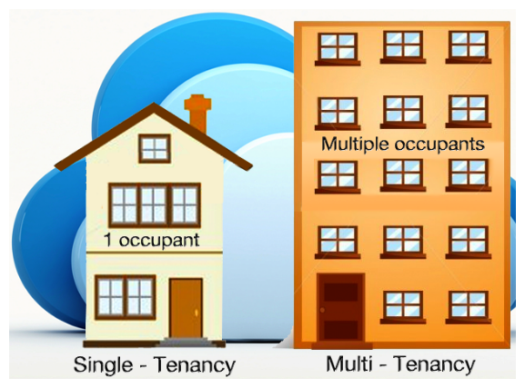

Slide 29
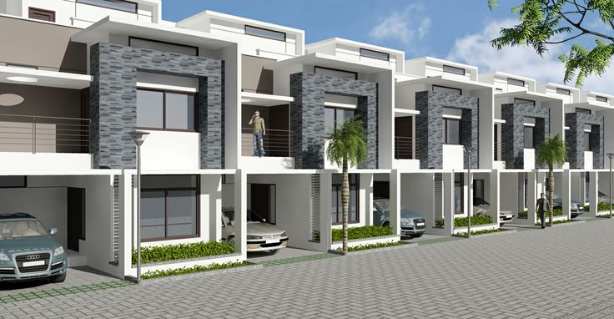
Single Tenant
A Single-Tenant is like an induvial villa house, leased fully by one person.
All the floor & amenities (instances) are owned by a single person or owner
The overall cost is higher because the entire ecosystem is paid for by a single owner.

Slide 30
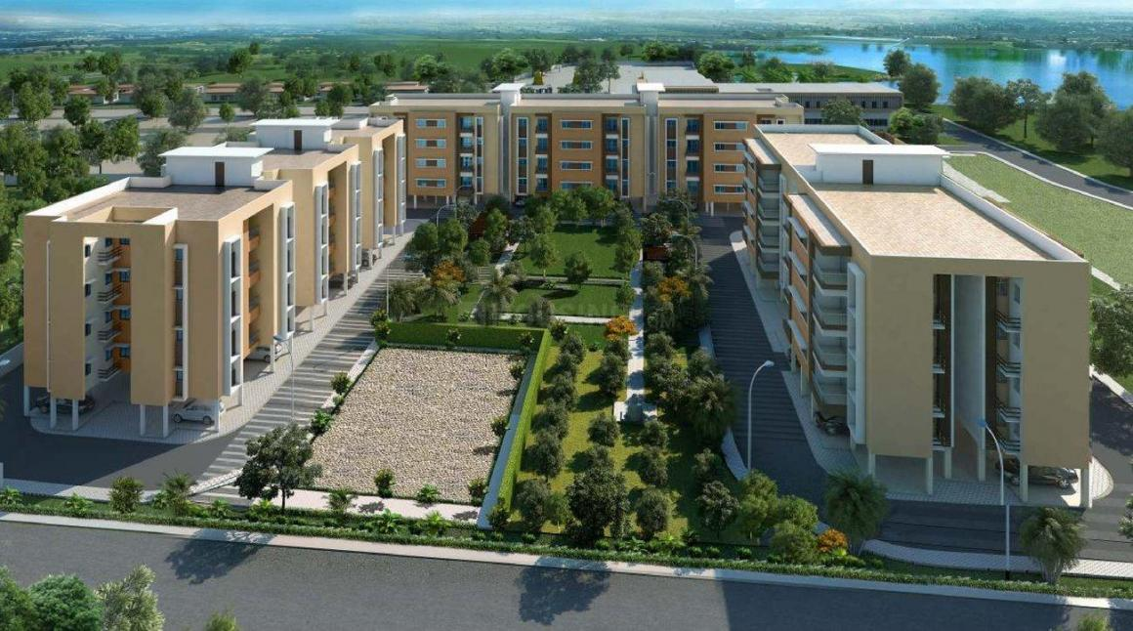
Multi-Tenancy
A Multi-Tenant is like a flat house,
Each flat in a floor is leased by multiple owners.
Each customer shares single application and a database.
Each tenant's data is isolated and remains invisible to other tenants

Slide 31
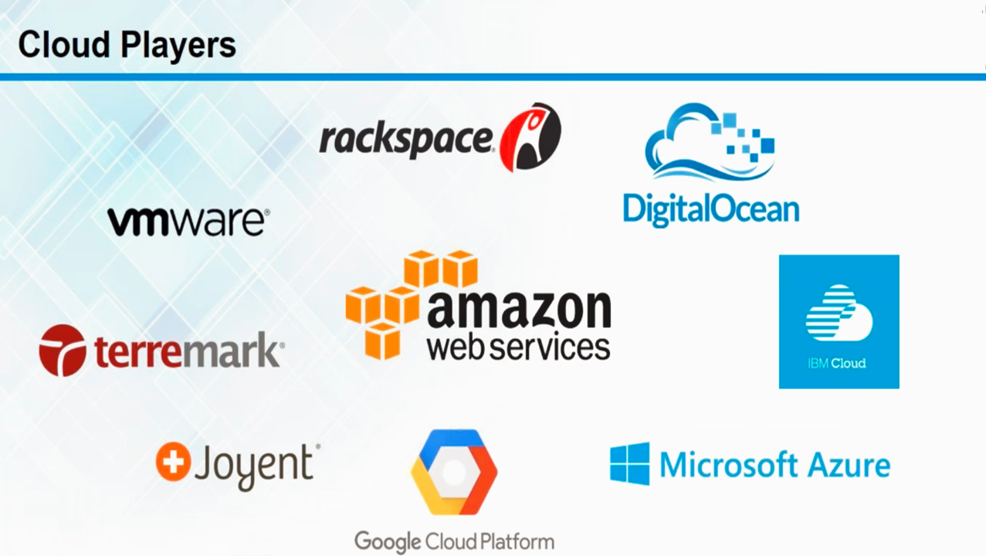

Slide 32
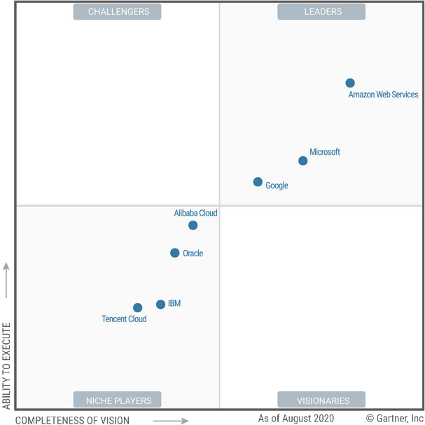
2023 Magic Quadrant for Cloud IaaS and PaaS

Slide 33
AWS
Introduction to AWS

Slide 34
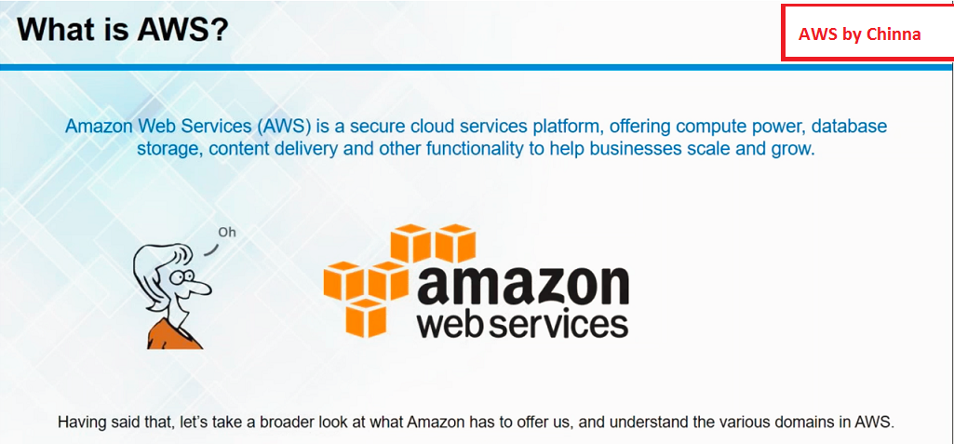

Slide 35
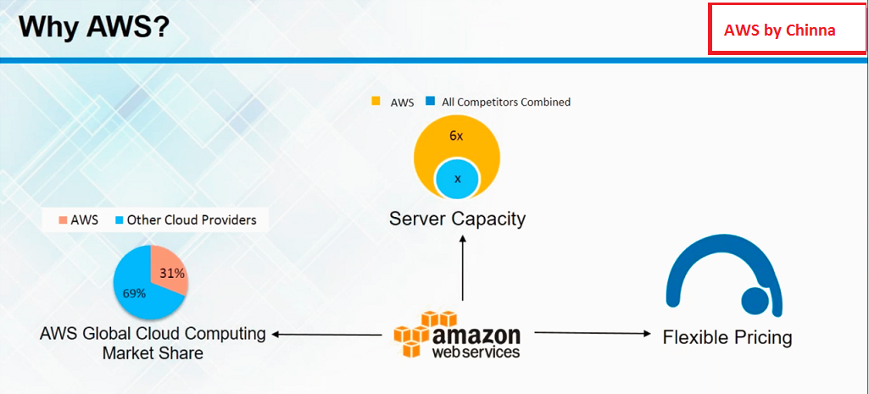

Slide 36
Aws Concepts
AWS Services

Slide 37
AWS services
IaaS
Paas
SaaS

Slide 38
Aws Concepts
AWS Pricing

Slide 39
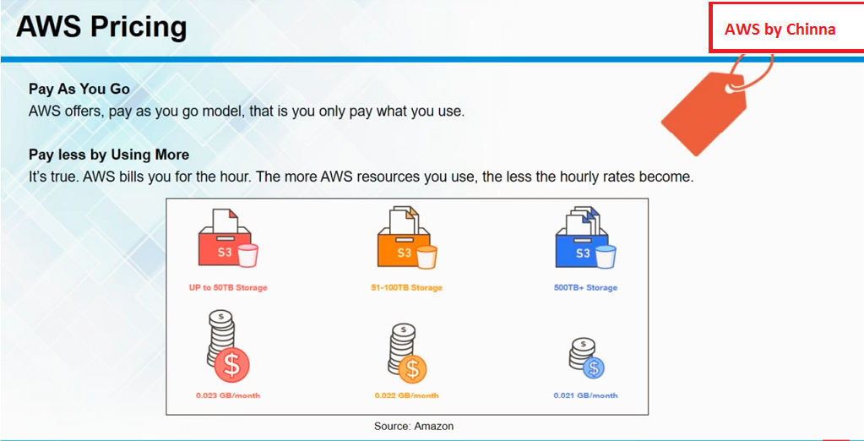

Slide 40
Aws Concepts
Job Roles in Cloud

Slide 41
Job Roles
On premises
Cloud Job roles

Slide 42
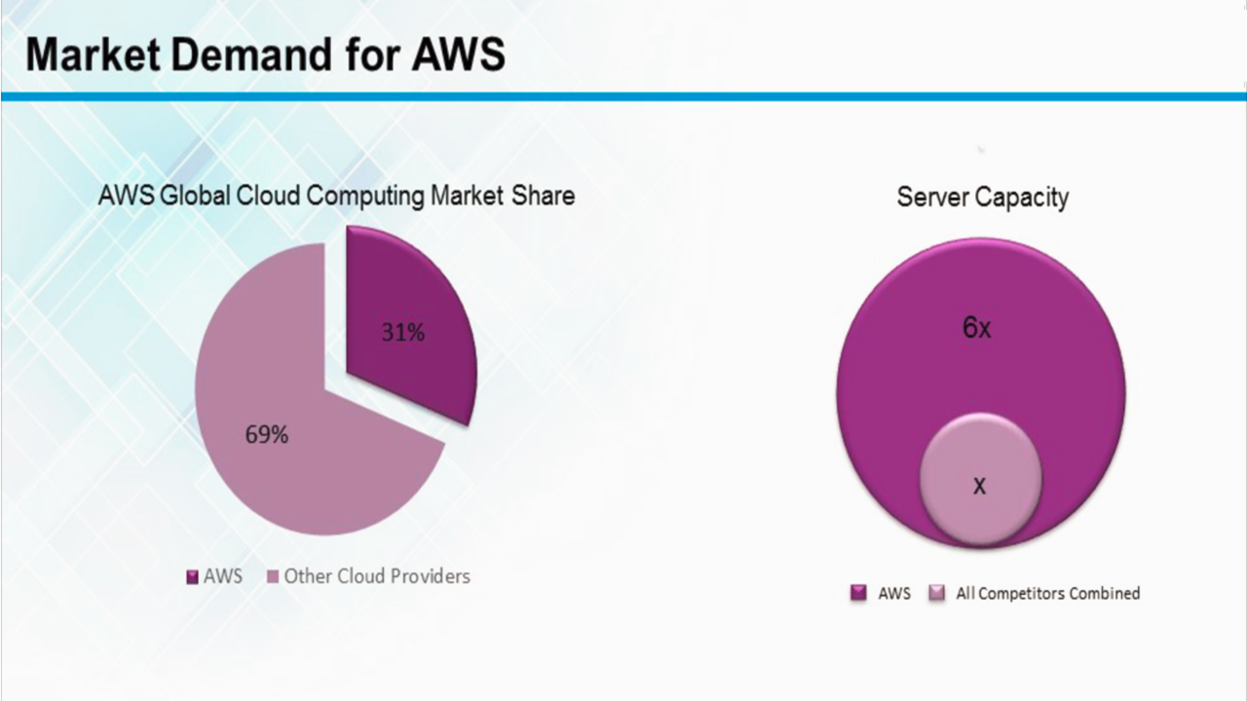

Slide 43
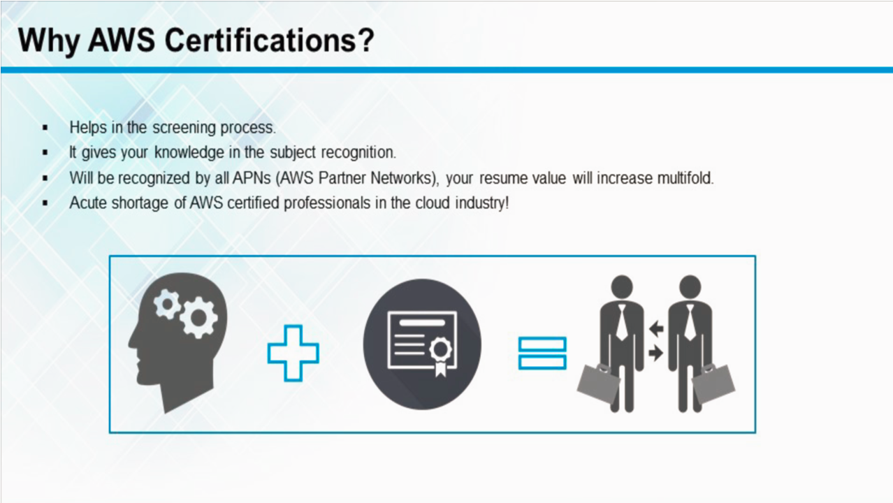

Slide 44
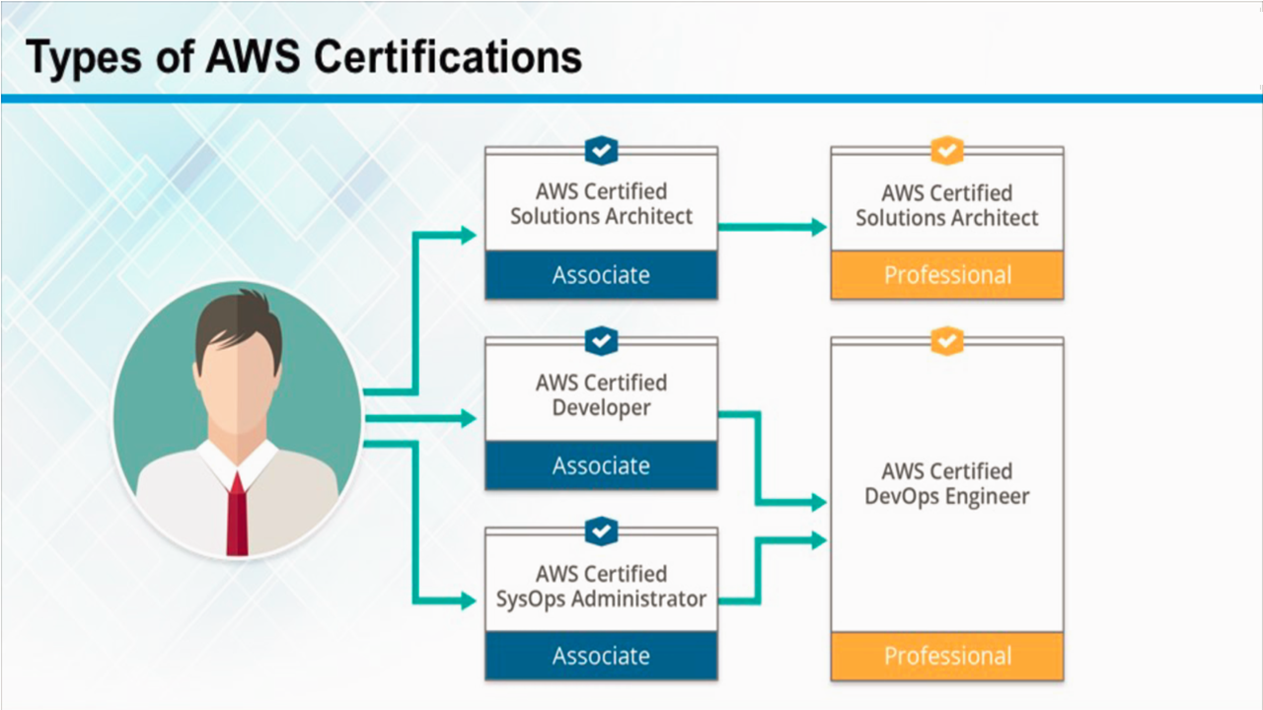

Slide 45
AWS Concepts
AWS and the Cloud
AWS Global Infrastructure
Introduction to Core AWS Services
What Next

Slide 46
The History of AWS so far
AWS Global Infrastructure

Slide 47
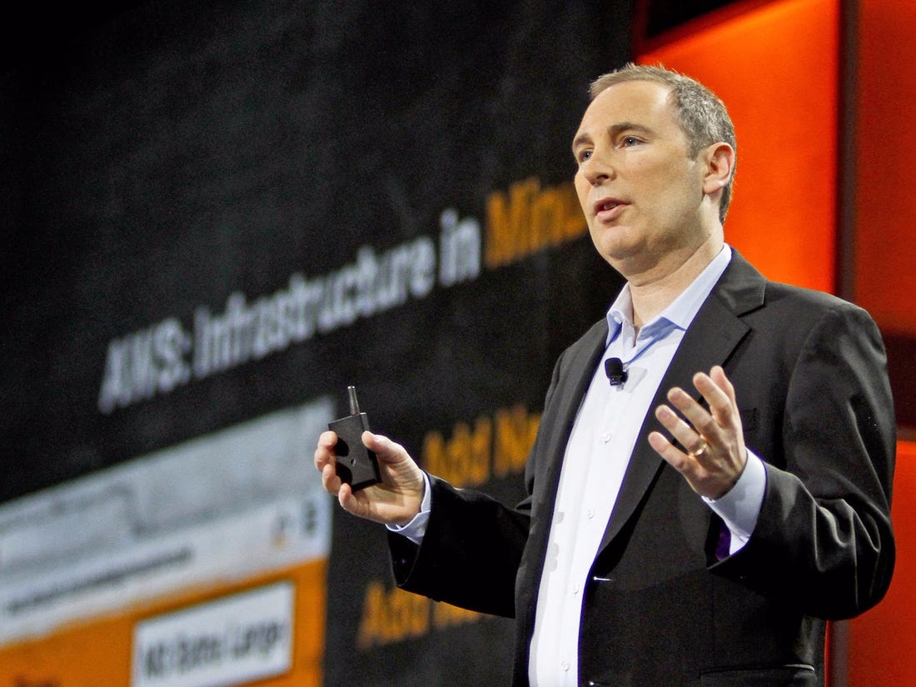
The History of AWS so FAR
“ Invention requires two things: 1. The ability to try a lot of experiments and 2. not having to live with the collateral damage of failed experiments”
Andy Jassy
CEO Amazon Web Services

Slide 48
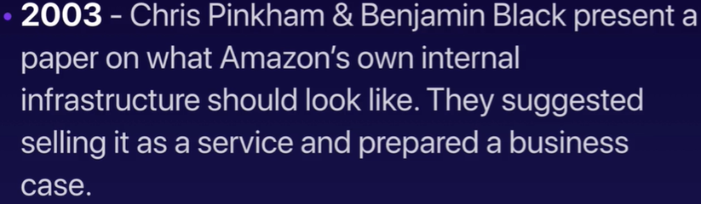
A brief History of AWS

Slide 49
A brief History of AWS

Slide 50
AWS – 10,000-foot overview
AWS Global Infrastructure

Slide 51
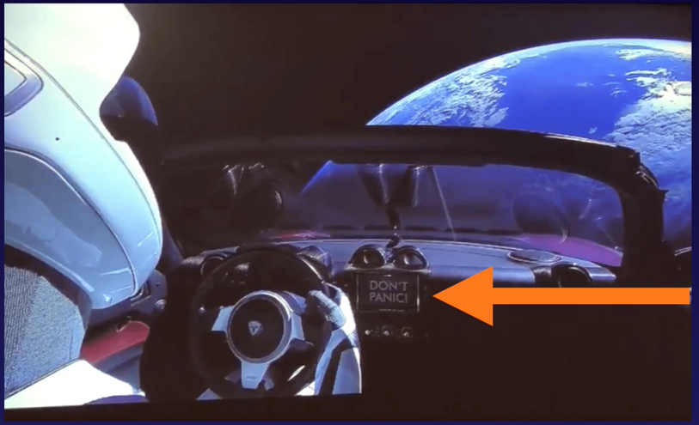
Don’t Panic

Slide 52
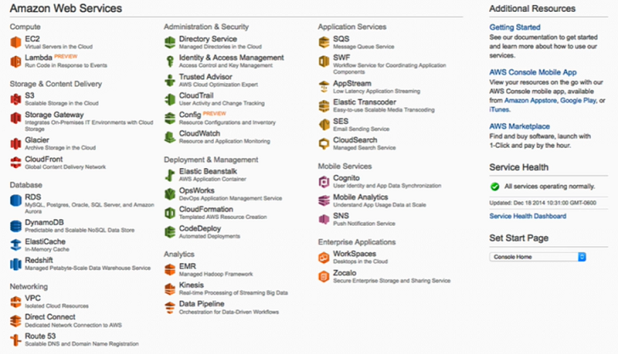
AWS Console - 2015

Slide 53
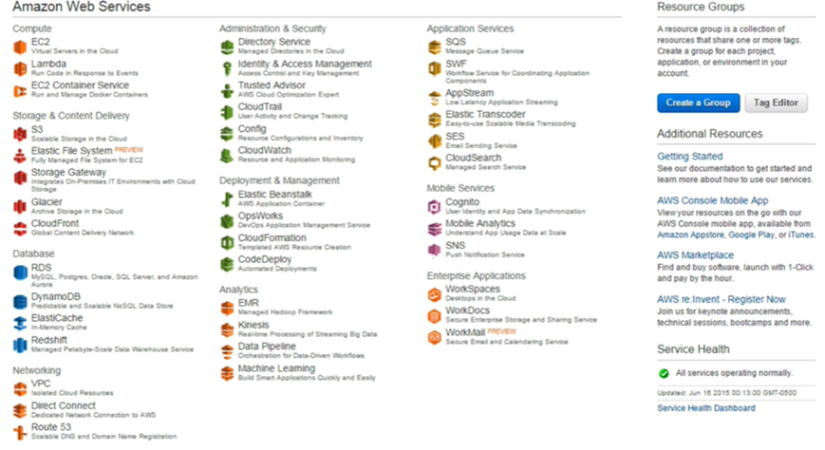
AWS Console - 2016

Slide 54
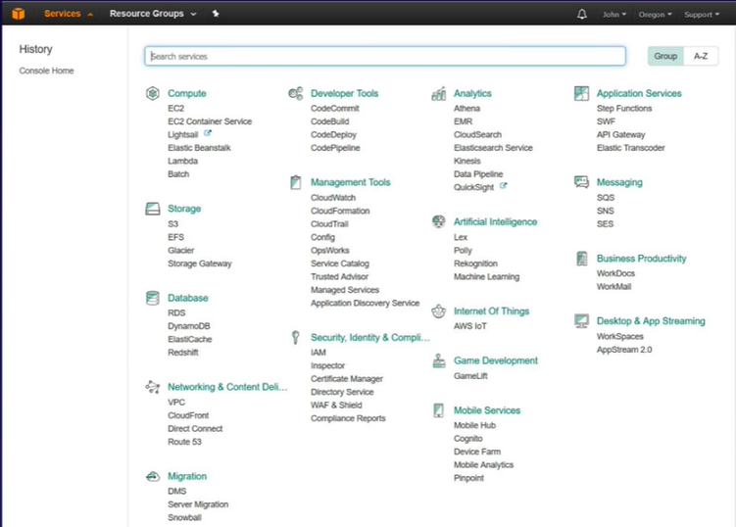
AWS Console - 2017

Slide 55
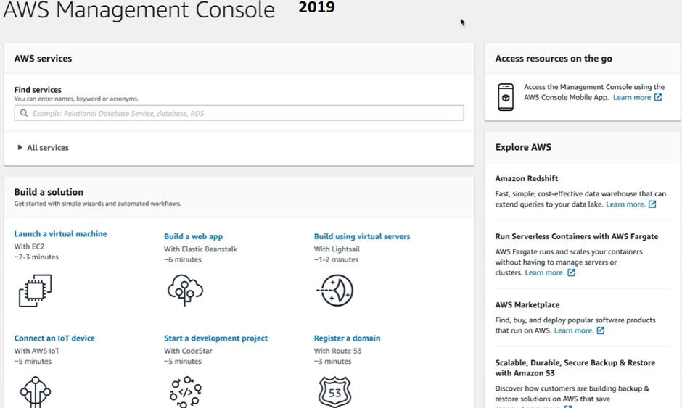

Slide 56
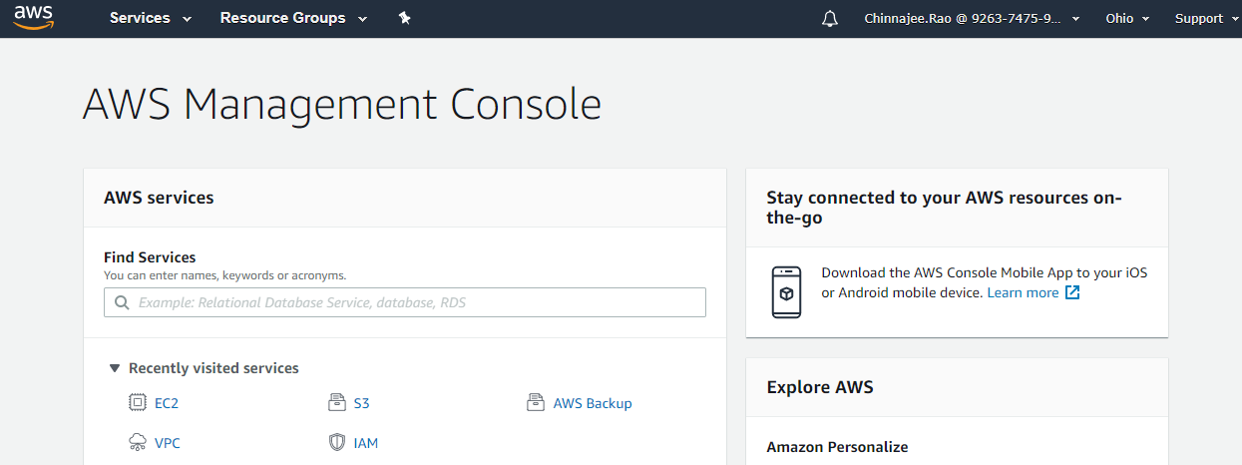
2020

Slide 57
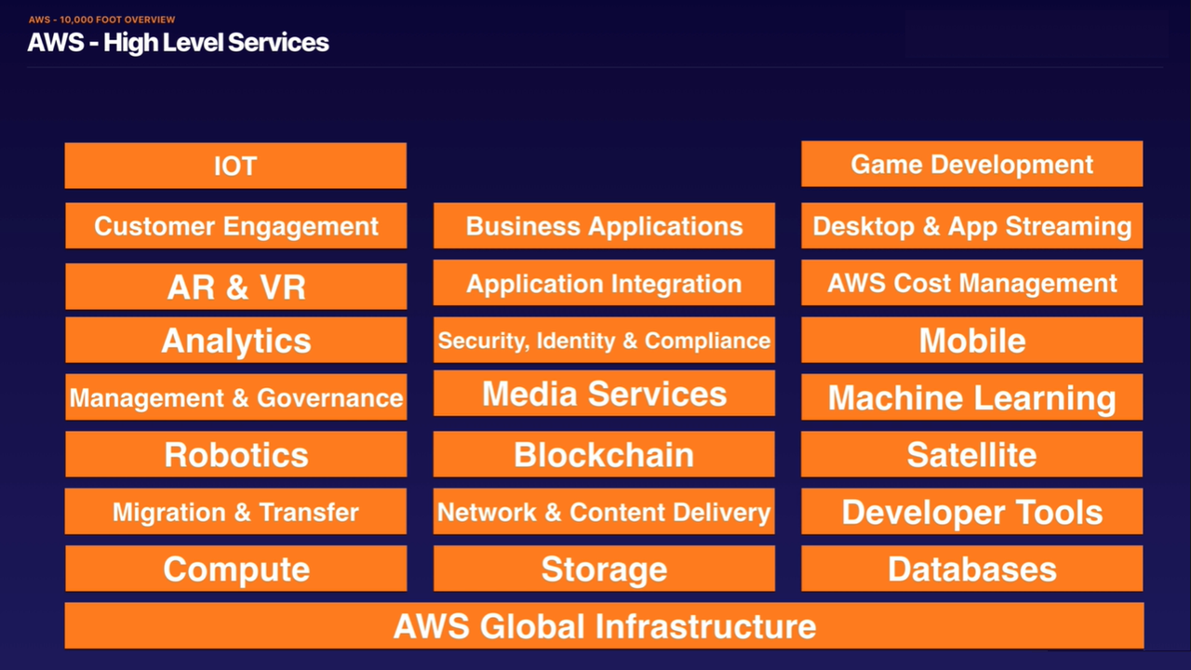

Slide 58

Rack servers – DataCenter inside
Data Center
Is a Building
Filled with
Servers

Slide 59
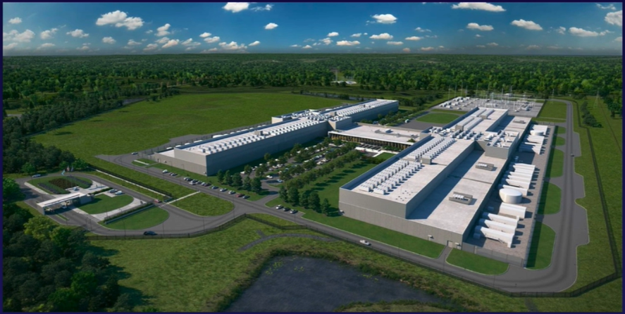
AWS – Data Center
Think of an availability Zone as a Data Center

Slide 60

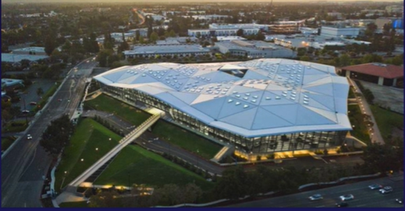
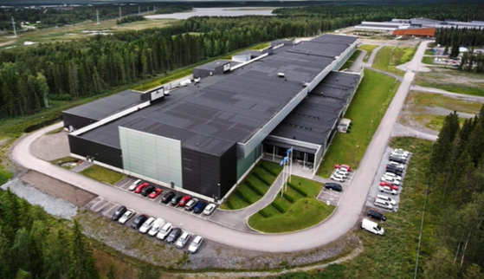
Availability Zone = Collection of Data centers with in a state

Slide 61
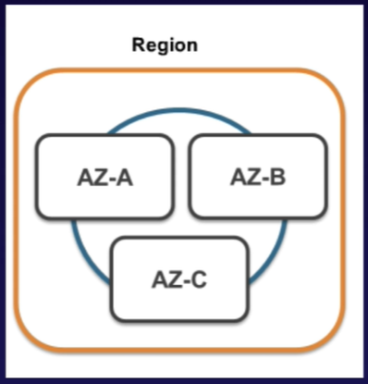


Slide 62
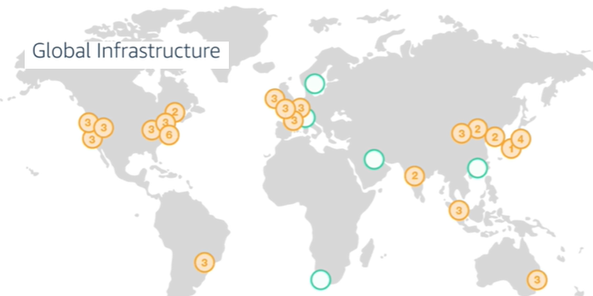

AWS – Regions – 2018/19

Slide 63
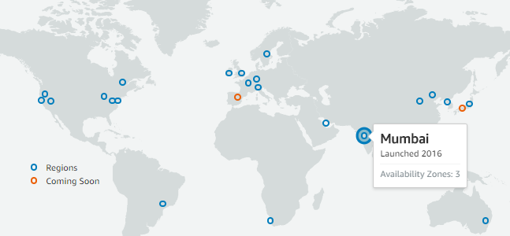
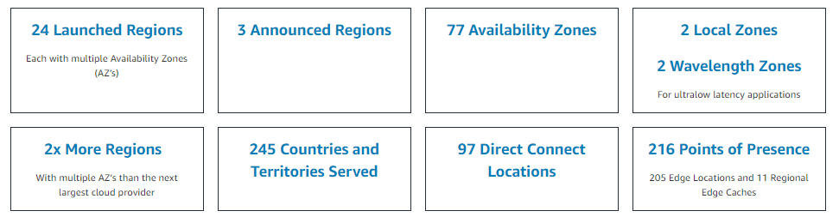
AWS – Regions - 2020

Slide 64
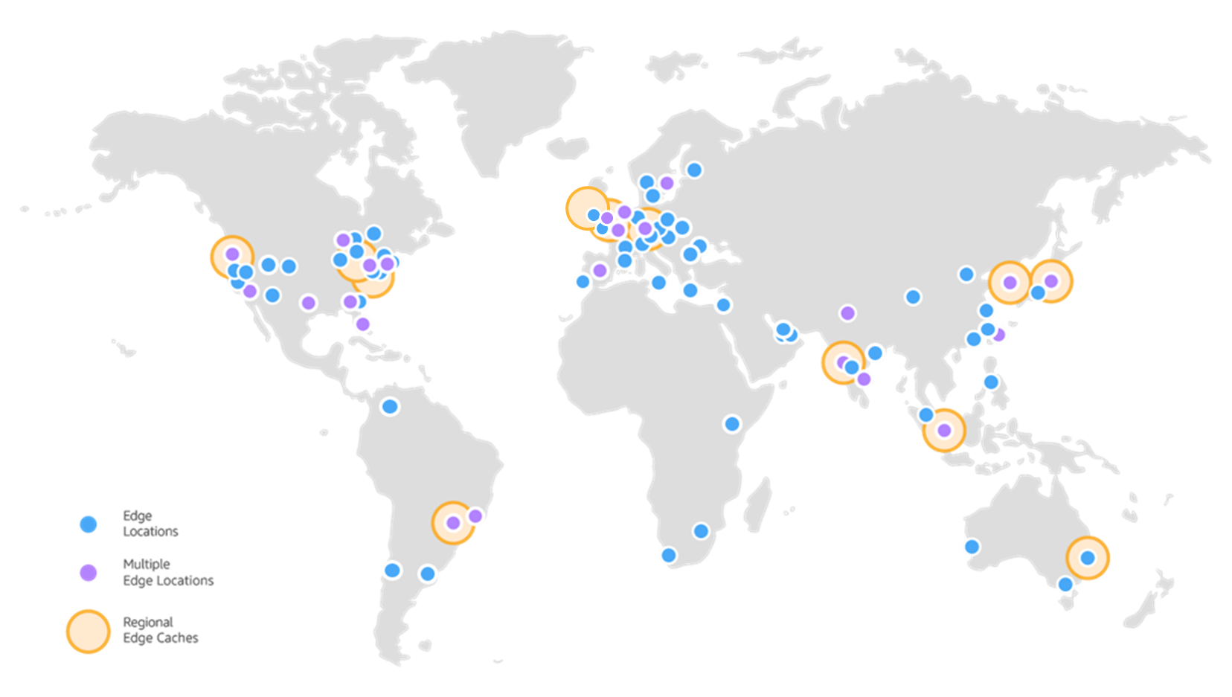
The Amazon CloudFront Global Edge Network

Slide 65
AWS New announcement
Puneet Chandok, President AWS India and South Asia, AISPL has announcement as per below:
AWS soon launch a Hyderabad region in 2022 with 3 AZ (one in Mumbai with 3 AZ and one in (future) Hyderabad with 3 AZ) and 18 edge location across India includes Chennai, Hyderabad, Bangalore, Mumbai, Delhi, and Kolkata

Slide 66
For more info
https://infrastructure.aws/

Slide 67
Question 1
What is an Amazon VPC?
virtual private compute
virtual private cloud
virtual public compute
virtual public cloud

Slide 68
Question 1
What is an Amazon VPC?
virtual private compute
virtual private cloud
virtual public compute
virtual public cloud
Good job!
VPC stands for Virtual Private Cloud.

Slide 69
Question 2
An AWS VPC is a component of which group of AWS services?
Global infrastructure
Database services
Network services
compute services

Slide 70
Question 2
An AWS VPC is a component of which group of AWS services?
Global infrastructure
Database services
Network services
compute services
Good job!
A Virtual Private Cloud (VPC) is a virtual network dedicated to a single AWS account. It is logically isolated from other virtual networks in the AWS cloud, providing compute resources with security and robust networking functionality.

Slide 71
Question 3:
What does an AWS Region consist of?
A console that gives you a quick, global picture of your cloud computing environment
A collection of database that can only be accessed from a specific geographic region.
A collection of datacenter that is spread around a specific continent
A collection of location within a geographic area designed to provide high Availability to a specific geography

Slide 72
Question 3:
What does an AWS Region consist of?
A console that gives you a quick, global picture of your cloud computing environment
A collection of database that can only be accessed from a specific geographic region.
A collection of datacenter that is spread around a specific continent
A collection of location within a geographic area designed to provide high Availability to a specific geography
Good job!
Each region is a separate geographic area. Each region has multiple, isolated locations known as Availability Zones.

Slide 73
Question 4
Which statement best describes Availability Zones?
A content distribution network used to distribute content to users
Restricted area designed specially for the creation of virtual private clouds
Two zones containing compute resources that are designed to automatically maintain synchronized copies of each other’s data
Distinct locations from within from AWS region that are engineered to be isolated from failure

Slide 74
Question 4
Which statement best describes Availability Zones?
A content distribution network used to distribute content to users
Restricted area designed specially for the creation of virtual private clouds
Two zones containing compute resources that are designed to automatically maintain synchronized copies of each other’s data
Distinct locations from within from AWS region that are engineered to be isolated from failure
Good job!
An Availability Zone (AZ) is a distinct location within an AWS Region. Each Region comprises at least two AZs.

Slide 75
Question 5:
What is an AWS region?
A region is an independent data center, located in different countries around the globe
A region is a geographical area divided into Availability Zones; Each region consists of at lease two availability zones
A region is a collection of Edge locations available in a specific countries
A region is a subset of AWS technologies. For example, the compute region of EC2, ECS, Lambda, etc.

Slide 76
Question 5:
What is an AWS region?
A region is an independent data center, located in different countries around the globe
A region is a geographical area divided into Availability Zones; Each region consists of at lease two availability zones
A region is a collection of Edge locations available in a specific countries
A region is a subset of AWS technologies. For example, the compute region of EC2, ECS, Lambda, etc.
Good job!
A region is a geographical area divided into Availability Zones. Each region contains at least two Availability Zones.

Slide 77
Question 6:
Which of the following is correct?
# of Regions > # of Availability Zones > # of Edge locations
# of Availability Zones > # of Edge locations > # of Regions
# of Edge locations > # of Regions # of Availability Zones
# of Edge locations > # of Availability Zones # of Regions

Slide 78
Question 6
Which of the following is correct?
# of Regions > # of Availability Zones > # of Edge locations
# of Availability Zones > # of Edge locations > # of Regions
# of Edge locations > # of Regions # of Availability Zones
# of Edge locations > # of Availability Zones # of Regions
Good job!
The number of Edge Locations is greater than the number of Availability Zones, which is greater than the number of Regions.

Slide 79
Question 7:
In which of the following is CloudFront content cached?
Availability Zone
Region
Edge location
Data Center

Slide 80
Question 7:
In which of the following is CloudFront content cached?
Availability Zone
Region
Edge location
Data Center
Good job!
CloudFront content is cached in Edge Locations.

Slide 81
What you know These are questions you got right on the first try.
What is an Amazon VPC?
An AWS VPC is a component of which group of AWS services?
What does an AWS Region consist of?
Which statement best describes Availability Zones?
What is an AWS region?
Which of the following is correct?
In which of the following is CloudFront content cached?

Slide 82
Summary
VPC stands for Virtual Private Cloud.
A Virtual Private Cloud (VPC) is a virtual network dedicated to a single AWS account. It is logically isolated from other virtual networks in the AWS cloud, providing compute resources with security and robust networking functionality.
Each region is a separate geographic area. Each region has multiple, isolated locations known as Availability Zones.
An Availability Zone (AZ) is a distinct location within an AWS Region. Each Region comprises at least two AZs.

Slide 83
Summary
A region is a geographical area divided into Availability Zones. Each region contains at least two Availability Zones.
The number of Edge Locations is greater than the number of Availability Zones, which is greater than the number of Regions.
CloudFront content is cached in Edge Locations.

Slide 84
AWS Concepts
AWS and the Cloud
AWS Global Infrastructure
Introduction to Core AWS Services
What Next

Slide 85
AWS Core Domain Services
AWS Concepts

Slide 86
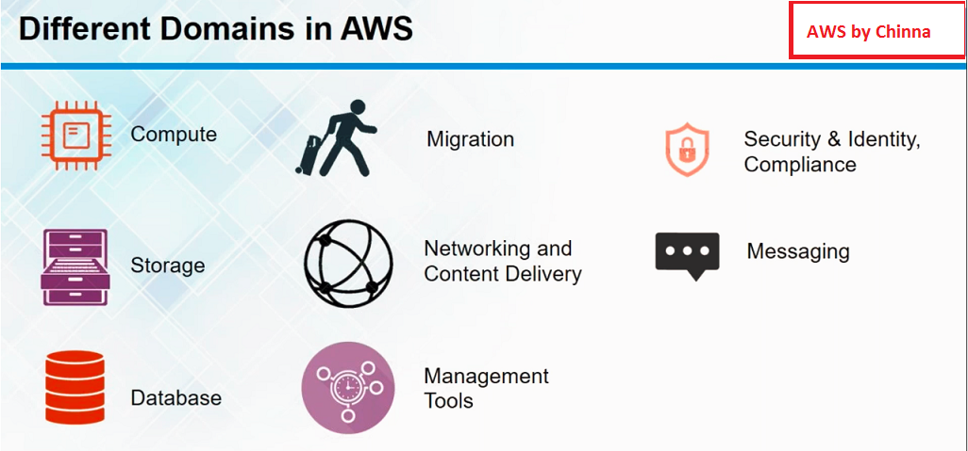

Slide 87
AWS Core Domain Services
AWS Compute Service

Slide 88
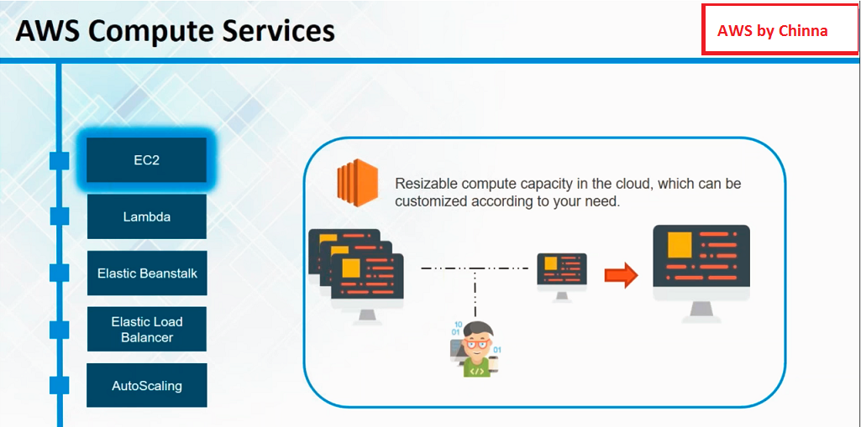

Slide 89
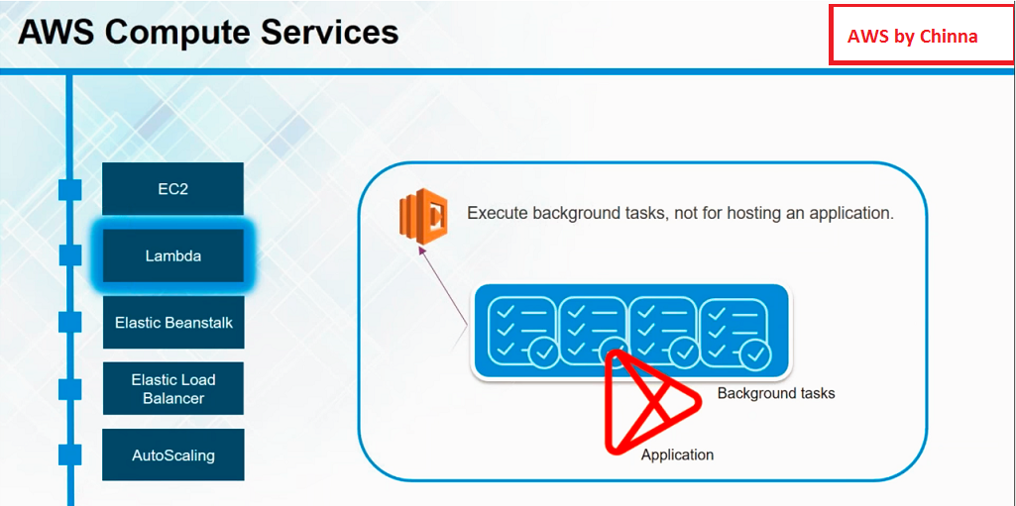

Slide 90
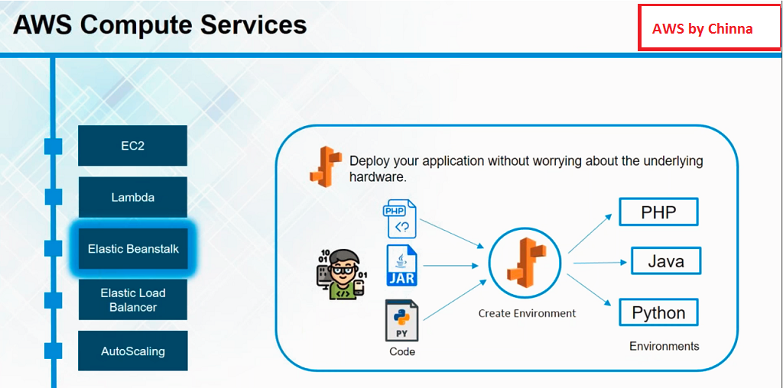

Slide 91
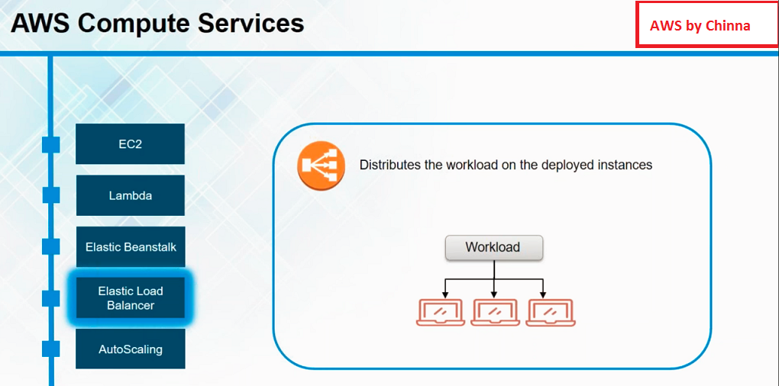

Slide 92
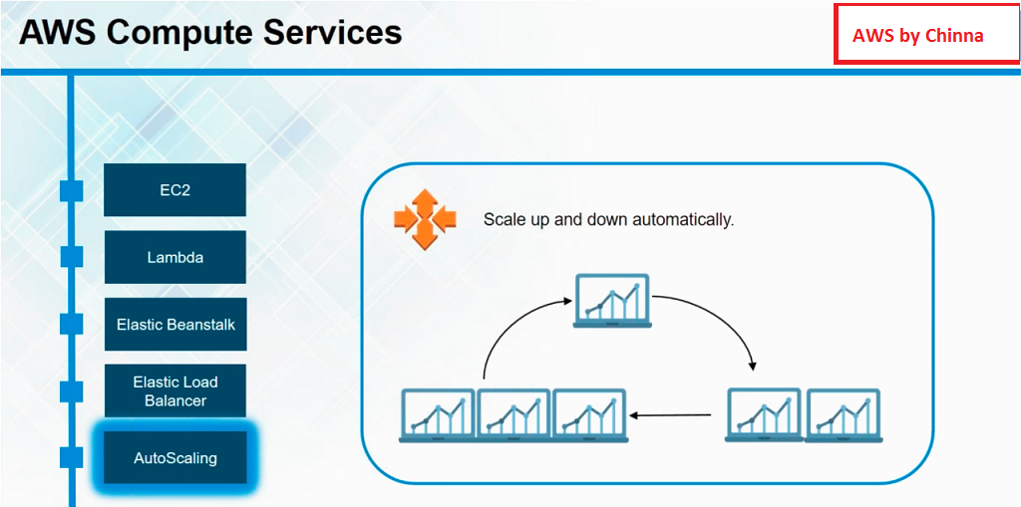

Slide 93
AWS Core Domain Services
AWS Networking Service

Slide 94
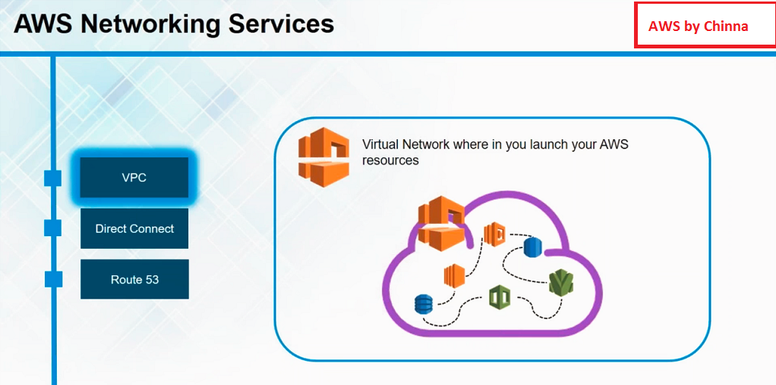

Slide 95
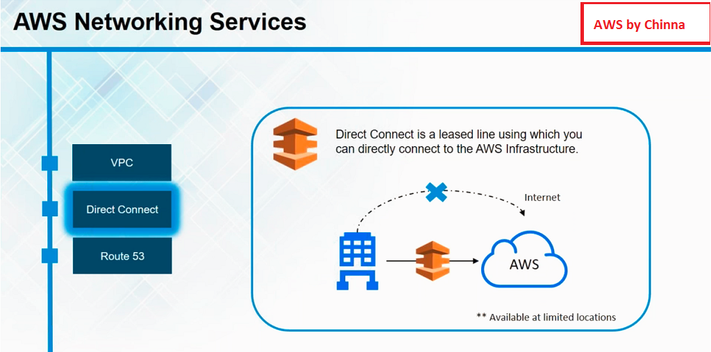

Slide 96
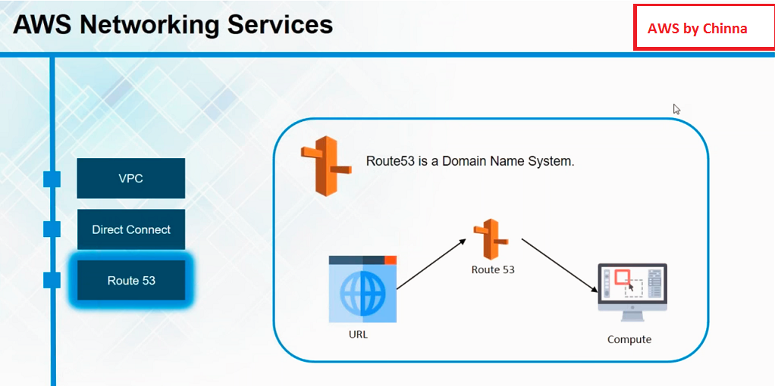

Slide 97
AWS Core Domain Services
AWS Storage Service

Slide 98
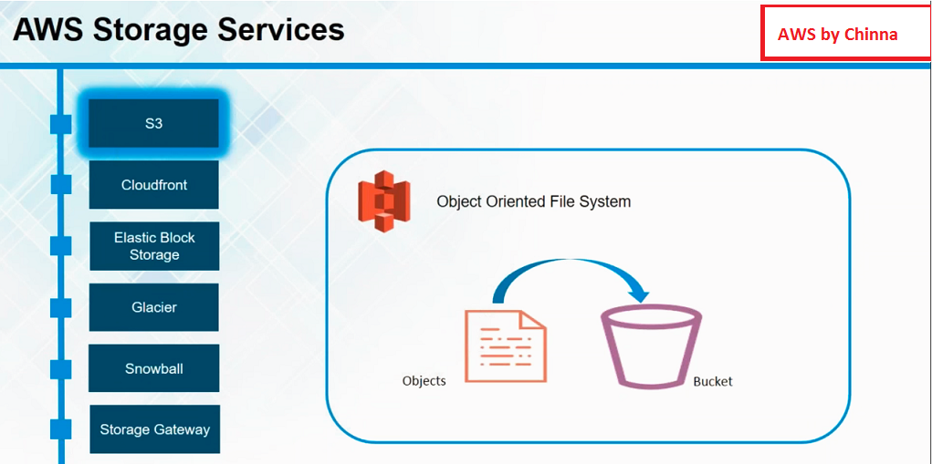

Slide 99
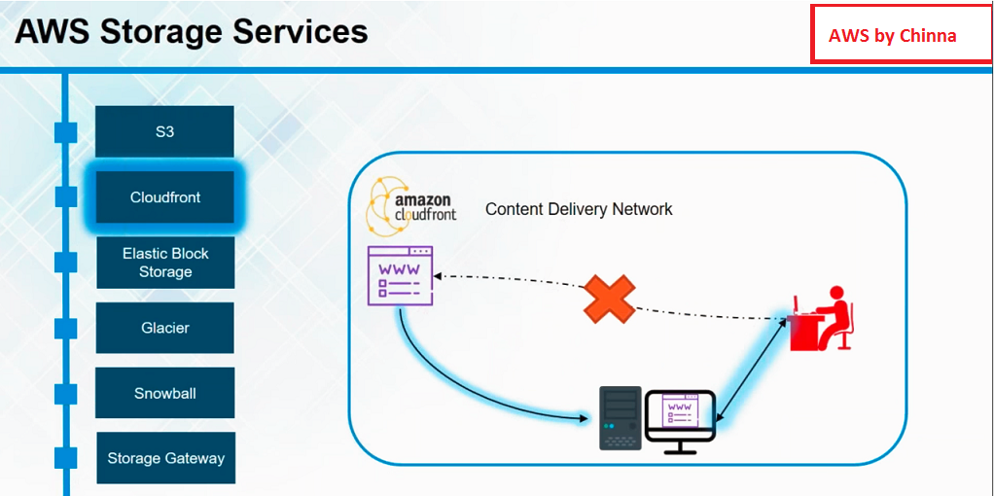

Slide 100
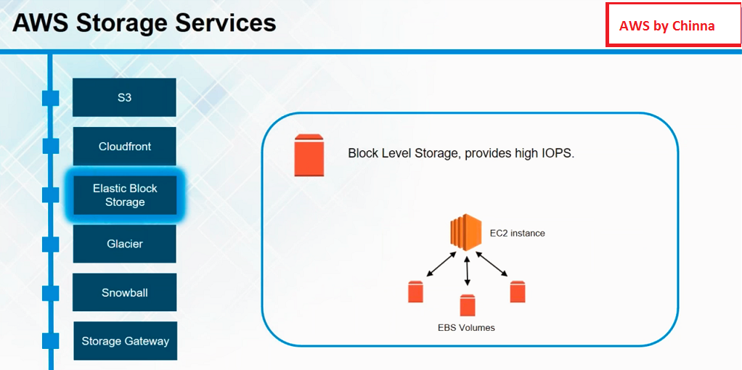

Slide 101


Slide 102


Slide 103

Snow Cone
2 CPUs, 4 GB of memory, 8 TB of usable storage, Wi-Fi or wired access, and USB-C power using a cord or optional battery.

Slide 104

Snowball

Slide 105

Snowball edge
Snowball Edge
Storage Optimized devices
provide both block storage and Amazon S3-compatible object storage, and 40 vCPUs. They are well suited for local storage and large scale-data transfer.
Compute Optimized devices
provide 52 vCPUs, block and object storage, and an optional GPU

Slide 106

Snowmobile
You can transfer up to 100PB per Snowmobile, a 45-foot long ruggedized shipping container, pulled by a semi-trailer truck.

Slide 107


Slide 108
AWS Core Domain Services
AWS Database Service

Slide 109


Slide 110


Slide 111


Slide 112


Slide 113


Slide 114
AWS Core Domain Services
AWS Management Service

Slide 115


Slide 116


Slide 117


Slide 118


Slide 119


Slide 120


Slide 121
AWS Core Domain Services
AWS Security Service

Slide 122


Slide 123
AWS Core Domain Services
AWS Application Service

Slide 124


Slide 125


Slide 126


